Slide 1
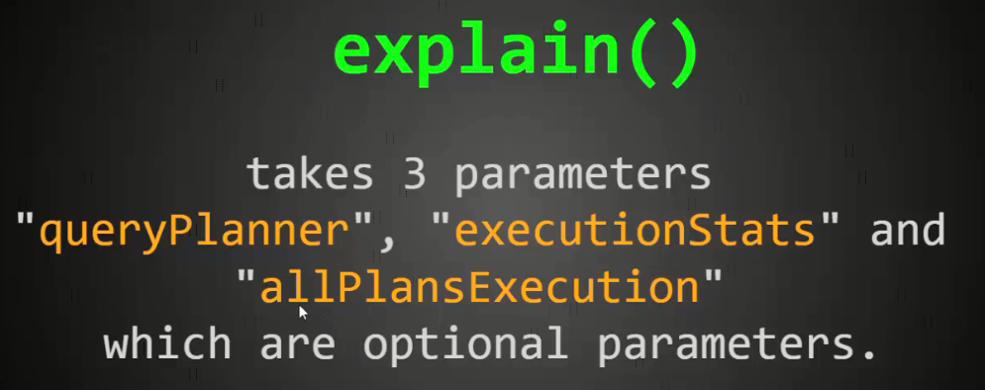
explain() method parameter options
The db.collection.explain() method is used to returns information on the query execution of various methods like aggregate(); count(); find(); group(); remove(); and update()

Slide 2
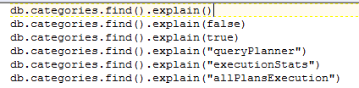
explain() method parameter options

